Slide 1

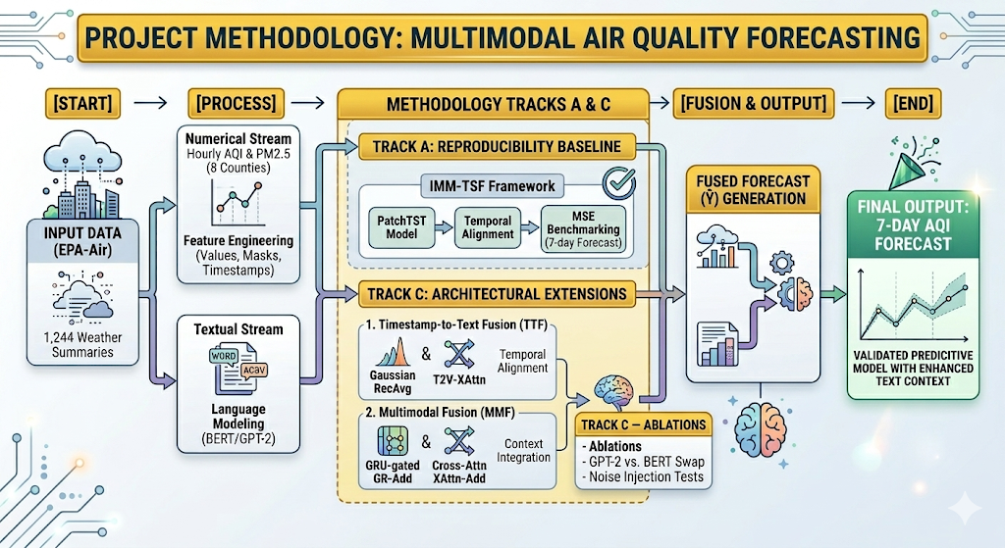
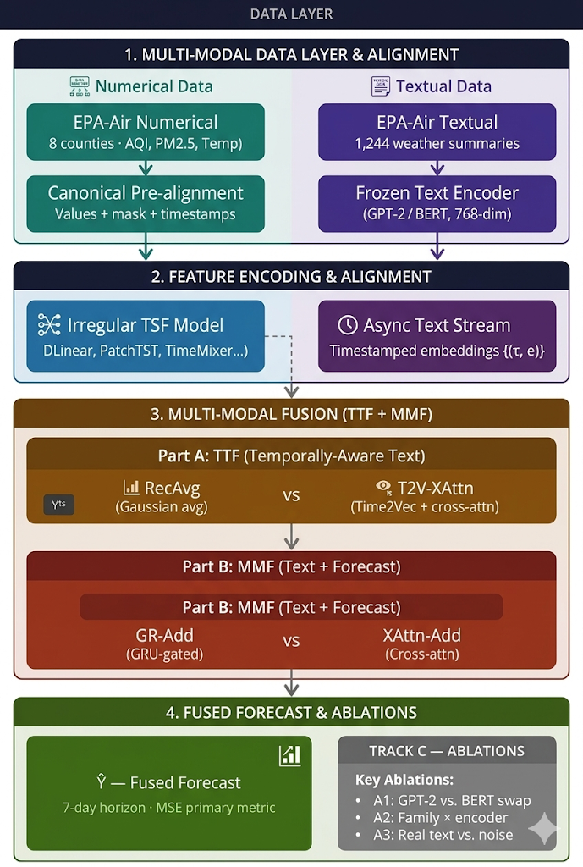
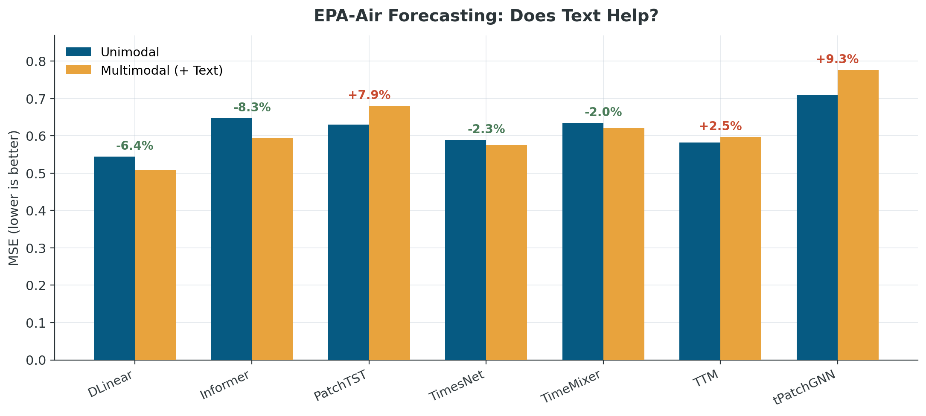
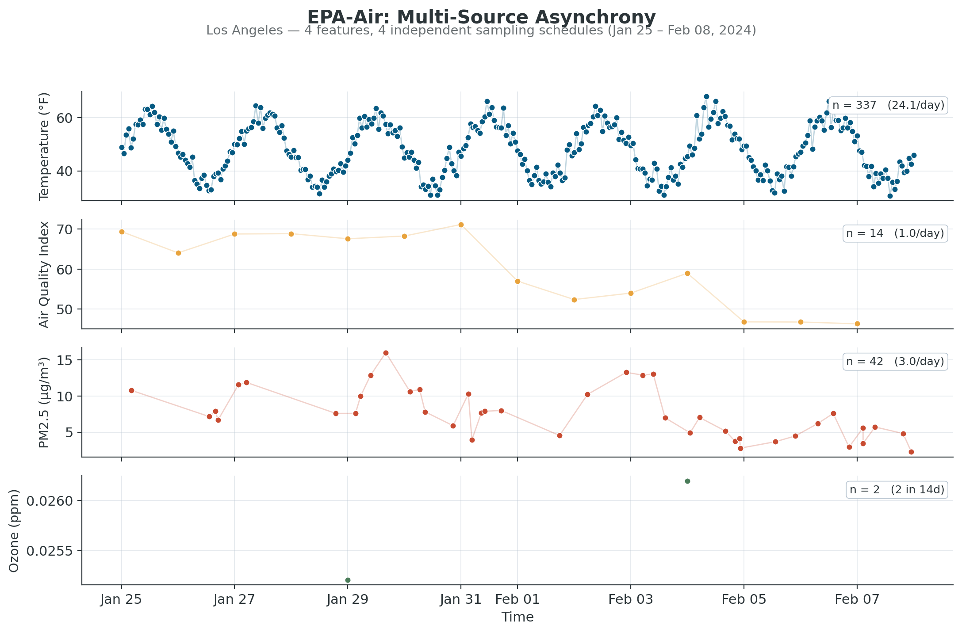
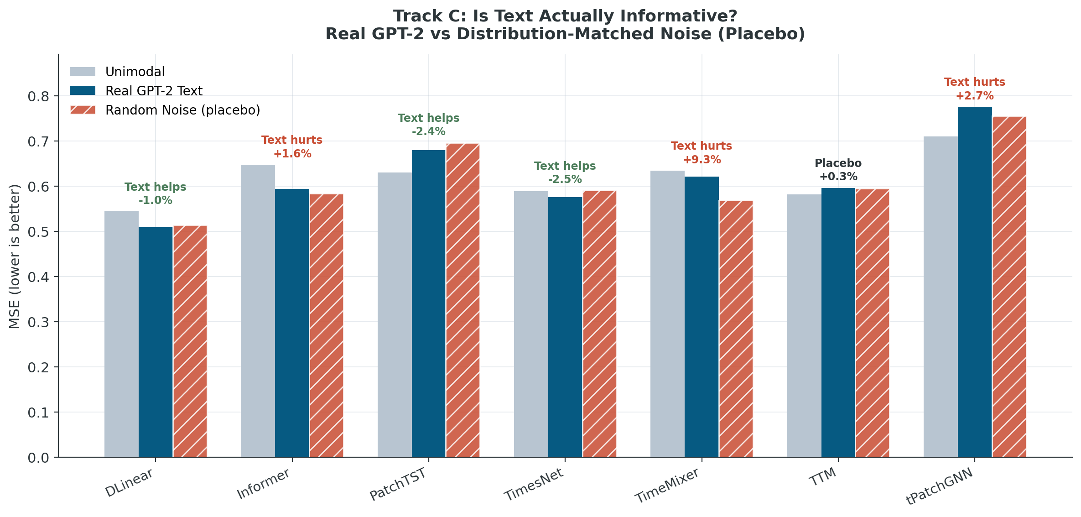




Replicating and Extending IMM-TSF: A Benchmarking Study on Irregular Multimodal Air Quality Data
Anil Vallepu, Param Venkat Vivek Kesireddy, Vineetha Burugupalli
Advisor: Dr. Bin Luo
Contact Details:
avallep1@students.kennesaw.edu
pkesire2@students.kennesaw.edu
vburugup@students.kennesaw.edu
ABSTRACT
SYSTEM ARCHITECTURE
This project investigates the challenges of forecasting using "messy" real-world data that includes both numerical sensors and unstructured text. Using the IMM-TSF (Irregular Multimodal Multivariate Time-Series Forecasting) framework, we focus on the EPA-Air dataset. In Track A, we successfully replicated the baseline performance metrics from the original research, confirming that integrating textual data reduces prediction error. In Track C, we propose an architectural extension to the modality fusion module to further enhance the model's ability to handle asynchronous data streams.
Traditional time-series models often assume that data is collected at regular intervals and consists only of numbers. However, real-world environmental data (like air quality) is often irregular and multimodal containing sensor readings alongside text-based reports or location metadata. This project utilizes the TIME-IMM benchmark to bridge the gap between clean laboratory datasets and complex, real-world deployment scenarios.
DATASETS USED
Figure 1 : Methodology
Dataset Name: EPA-Air (Artifact-Based Irregularities)
Geographical Scope: The dataset encompasses air quality monitoring across eight major U.S. cities each treated as an individual entity: Los-Angeles, Maricopa (Phoenix), Philadelphia, Bexar (San Antonio), Dallas, Richmond, Hillsborough and Denver
Numerical Modality: Air Quality Index (AQI), Ozone, PM_2.5, and Temperature.
Textual Modality: Unstructured news articles about Air quality.
RESULTS
Figure 4. Architecture diagram
CONCLUSION
Successful Reproducibility: The study successfully validated the IMM-TSF framework on the irregular EPA-Air dataset, confirming that multimodal integration of weather summaries generally enhances air quality forecasting accuracy.
Architecture-Dependent Gains: We found that Non-patch models (e.g., DLinear, Informer) are significantly more "text-friendly," while Patch-based architectures often struggle to integrate asynchronous text, showing that one size does not fit all in multimodal fusion.
Criticality of Encoder Selection: Contrary to the anchor paper's findings, our results prove that the choice between GPT-2 and BERT is crucial on sparse datasets; the right encoder choice flipped results for several models from "harmful" to "helpful.”
The Regularization Paradox: The placebo test revealed that for nearly half the models, random noise matched or beat real text. This suggests that some reported performance gains may stem from structural regularization rather than true semantic understanding of the weather text.
Figure 2: Track-A Results Replication
IMPACT & COMPETITIVE ADVANTAGE
Impact: The IMM-TSF framework transitions time-series research from "clean" laboratory environments to "messy" real-world applications. By successfully integrating asynchronous textual context with irregular sensor data, the model achieves up to a 38% reduction in forecasting error (MSE), demonstrating that multimodal data is critical for accurate predictions in complex domains like public health and environmental monitoring.
Competitive Advantage: Unlike standard forecasting models that assume regular data intervals, this approach features a unique Timestamp-to-Text Fusion (TTF) module. This allows for the "plug-and-play" integration of various Large Language Models (LLMs) to process text without forcing artificial alignment, enabling the model to outperform traditional unimodal benchmarks even when data is missing or sampled inconsistently.
FUTURE SCOPE
Future Direction: To truly bridge the "say vs. do" gap in environmental forecasting, future architectures must move beyond simple additive fusion and toward cross-modal attention strategies that account for the extreme sparsity found in real-world sensor data.
REFERENCES & MORE
Figure 3: Track-C Results
References
Anil
Param
Vineetha

